Slide 1
Integration of Large Language Model-based Agents into Machine Learning Operations Pipeline
Name: Bozhen Zhu
Study Program: Computer Science (Master)
Matr.-No.: 437997
Supervisor(s): Prof. Dr. Stefan Decker
Advisor(s): Yongli Mou, M.Sc.

Slide 2
Introduction
Outline of Introduction
Overview of Large Language Models (LLMs)
Machine Learning Operations (MLOps)
Potential of LLMs in MLOps
Motivation
Research Question

Slide 3
Introduction
Research Question
How can we effectively integrate Large Language Model-based agents into MLOps pipelines?
Will multi-agent system perform much better than single agent in solving MLOps tasks?

Slide 4
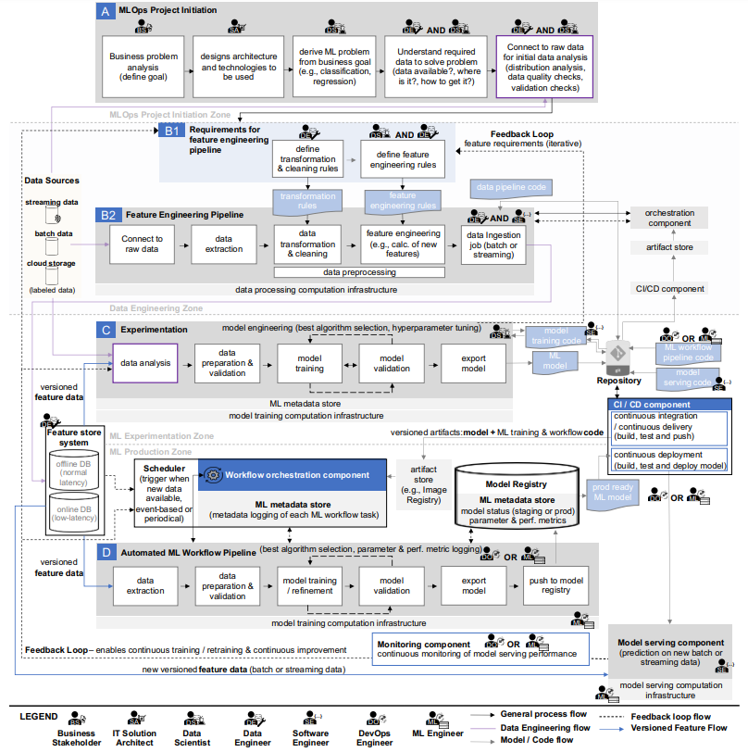
Literature Review
Complexity of MLOps
Machine Learning Operations (MLOps):
Overview, Definition, and Architecture

Slide 5
Literature Review
Use of LLMs in AI agents
The Rise and Potential of Large Language Model Based Agents: A Survey
Exploring Large Language Model based Intelligent Agents: Definitions, Methods, and Prospects
These two articles demonstrate that LLM already has the ability to generate human indistinguishable results based on input in many ways
Chain-of-Thought Prompting Elicits Reasoning in Large Language Models
ReAct: Synergizing Reasoning and Acting in Language Models
MetaGPT: Meta Programming for A Multi-Agent Collaborative Framework
These articles show that multi-agent systems perform better than single-agent when solving complex problems.

Slide 6
Research methodology
Develop of Single Agent
Take Data Scientist defined in the MLOps as an example, this agent should be able to:
Receive data, analyz it
Select the most suitable algorith
Training of the model
Export the model (both the code for model training and the instantiated model, e.g., the model's parameter values, etc.) and push it to a Git repository.
This requires at least:
Write prompts so that the agent can:
understand the upstream output format
perform tasks rationally
output in desired format
And write codes in python so that agent can
translate the upstream output to LLM understanble plain text
transform the plain text generated by LLM to e.g. runnable code
record results
...

Slide 7
Research methodology
Develop of Multi-Agent System
Manage the agents in MetaGPT defined system, which use the ReAct strategy
Define the enviorment and actions
Further develop of each agent, align it to perform correctly in the system
Enable agents to listen/respond to specific actions and publish its results to the enviorments
Allow human to play some roles instead of agents such that we can perform a ablation study

Slide 8
Expected Results
Gain a comprehensive understanding of the current state of Large Language Model (LLM) integration into machine learning operations pipelines
Derive the difference in capabilities between single-agent and multi-agent systems
Deriving the difference between the capabilities of agents based on several different large language models for MLOps tasks

Slide 9
Expected Results
Evaluation Indicator
Pass@k:
We evaluate whether in generated k versions is there any one could pass the unit-tests previously defined, which ask the system having key abilities:
Implement a artifacts stores
Implement code version controls
Respond to new data available
Deploy the model
Rounds n:
The agent is allowed to incrementally develop. We will test in how many rounds in average can an agent deliver the runable code.

Slide 10
Timetable
Feb.01 - Feb.29: Collection of relevant literature and preparation of experimental environment
Mar.01 - Mar.15: Completing the development of each single agent and maximize as much as possible its performance
Mar.16 - Apr.07: Integration of individual agents into metagpt's framework
Apr.08 - Apr.15: Evaluation
Apr.16 - Apr.30: Writing thesis

Slide 11
Reference List
The Rise and Potential of Large Language Model Based Agents: A Survey
Machine Learning Operations (MLOps): Overview, Definition, and Architecture
A Comprehensive Overview of Large Language Models
Exploring Large Language Model based Intelligent Agents: Definitions, Methods, and Prospects
Chain-of-Thought Prompting Elicits Reasoning in Large Language Models
ReAct: Synergizing Reasoning and Acting in Language Models
MetaGPT: Meta Programming for A Multi-Agent Collaborative Framework

